Slide 1
Deep Learning Road Lane Detection: Most Effective Way in Autonomous Systems

Slide 2
Objectives
The objective of this research is to develop an efficient and accurate system for real-time road lane and vehicle detection to enhance the safety and efficiency of autonomous vehicles and Advanced Driver-Assistance Systems (ADAS).
By integrating YOLOv8 for road lane detection and YOLO for vehicle detection, the system aims to achieve consistent performance under diverse conditions, including low lighting and occlusions.
Additionally, leveraging Streamlit for deployment provides an intuitive and scalable interface for monitoring and evaluation. The proposed system addresses critical challenges in autonomous driving, offering a deployable solution that contributes to advancing practical computer vision applications in the field.

Slide 3
Frame Work
Frontend:
We used streamlit HTML and CSS for visual styling.
Backend:
SQLite for database.
YOLOv8 for object detection.
OpenCV for lane detection and video processing.
Passlib for secure password handling.

Slide 4
Methodology
The loss functions include mean square error for bounding box predictions and binary cross-entropy for class probabilities. We performed hyperparameter tuning such as learning rate and batch size tuning to achieve convergence and prevent overfitting.
Mean Average Precision (mAP), frame per second (FPS), and Intersection over Union (IoU) were computed, to evaluate the performance of the system. This included the detection accuracy, the capability of the algorithm to process in real time and the accuracy of identifying lanes and vehicle.
The system was thoroughly tested on benchmark datasets and real-world scenarios, ensuring the reliability and robustness of the presented method.

Slide 5
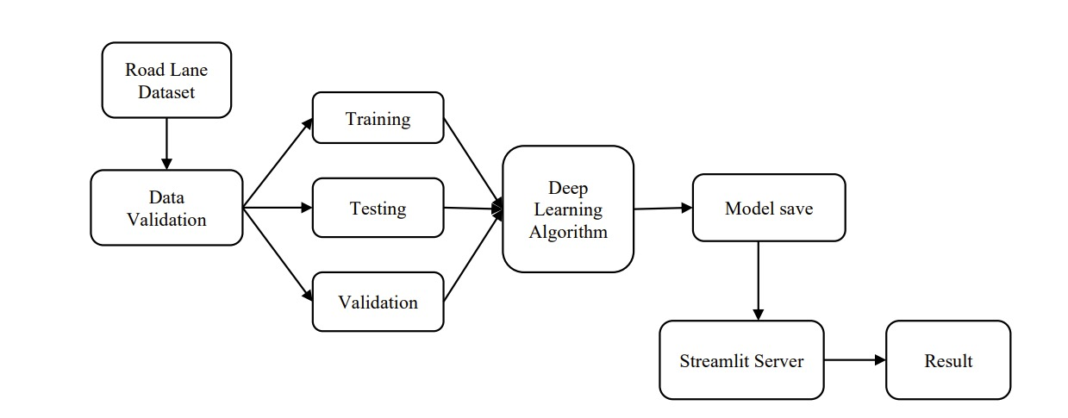
Architecture Methodology

Slide 6
Algorithm
YOLOv8Autonomous Vehicles: Detecting pedestrians, cars, and traffic signs in real time.
Retail: Object detection for inventory tracking and automated checkout systems.
Healthcare: Medical imaging for detecting tumors, anomalies, etc.
Agriculture: Monitoring crops and detecting weeds, pests, and diseases.
Surveillance: Intrusion detection and activity monitoring.

Slide 7
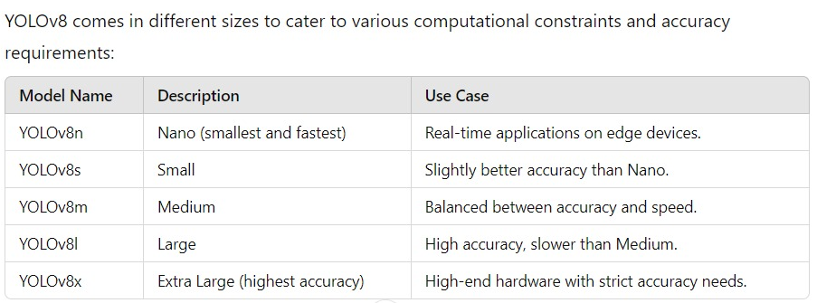
YOLOv8 Model Variants

Slide 8
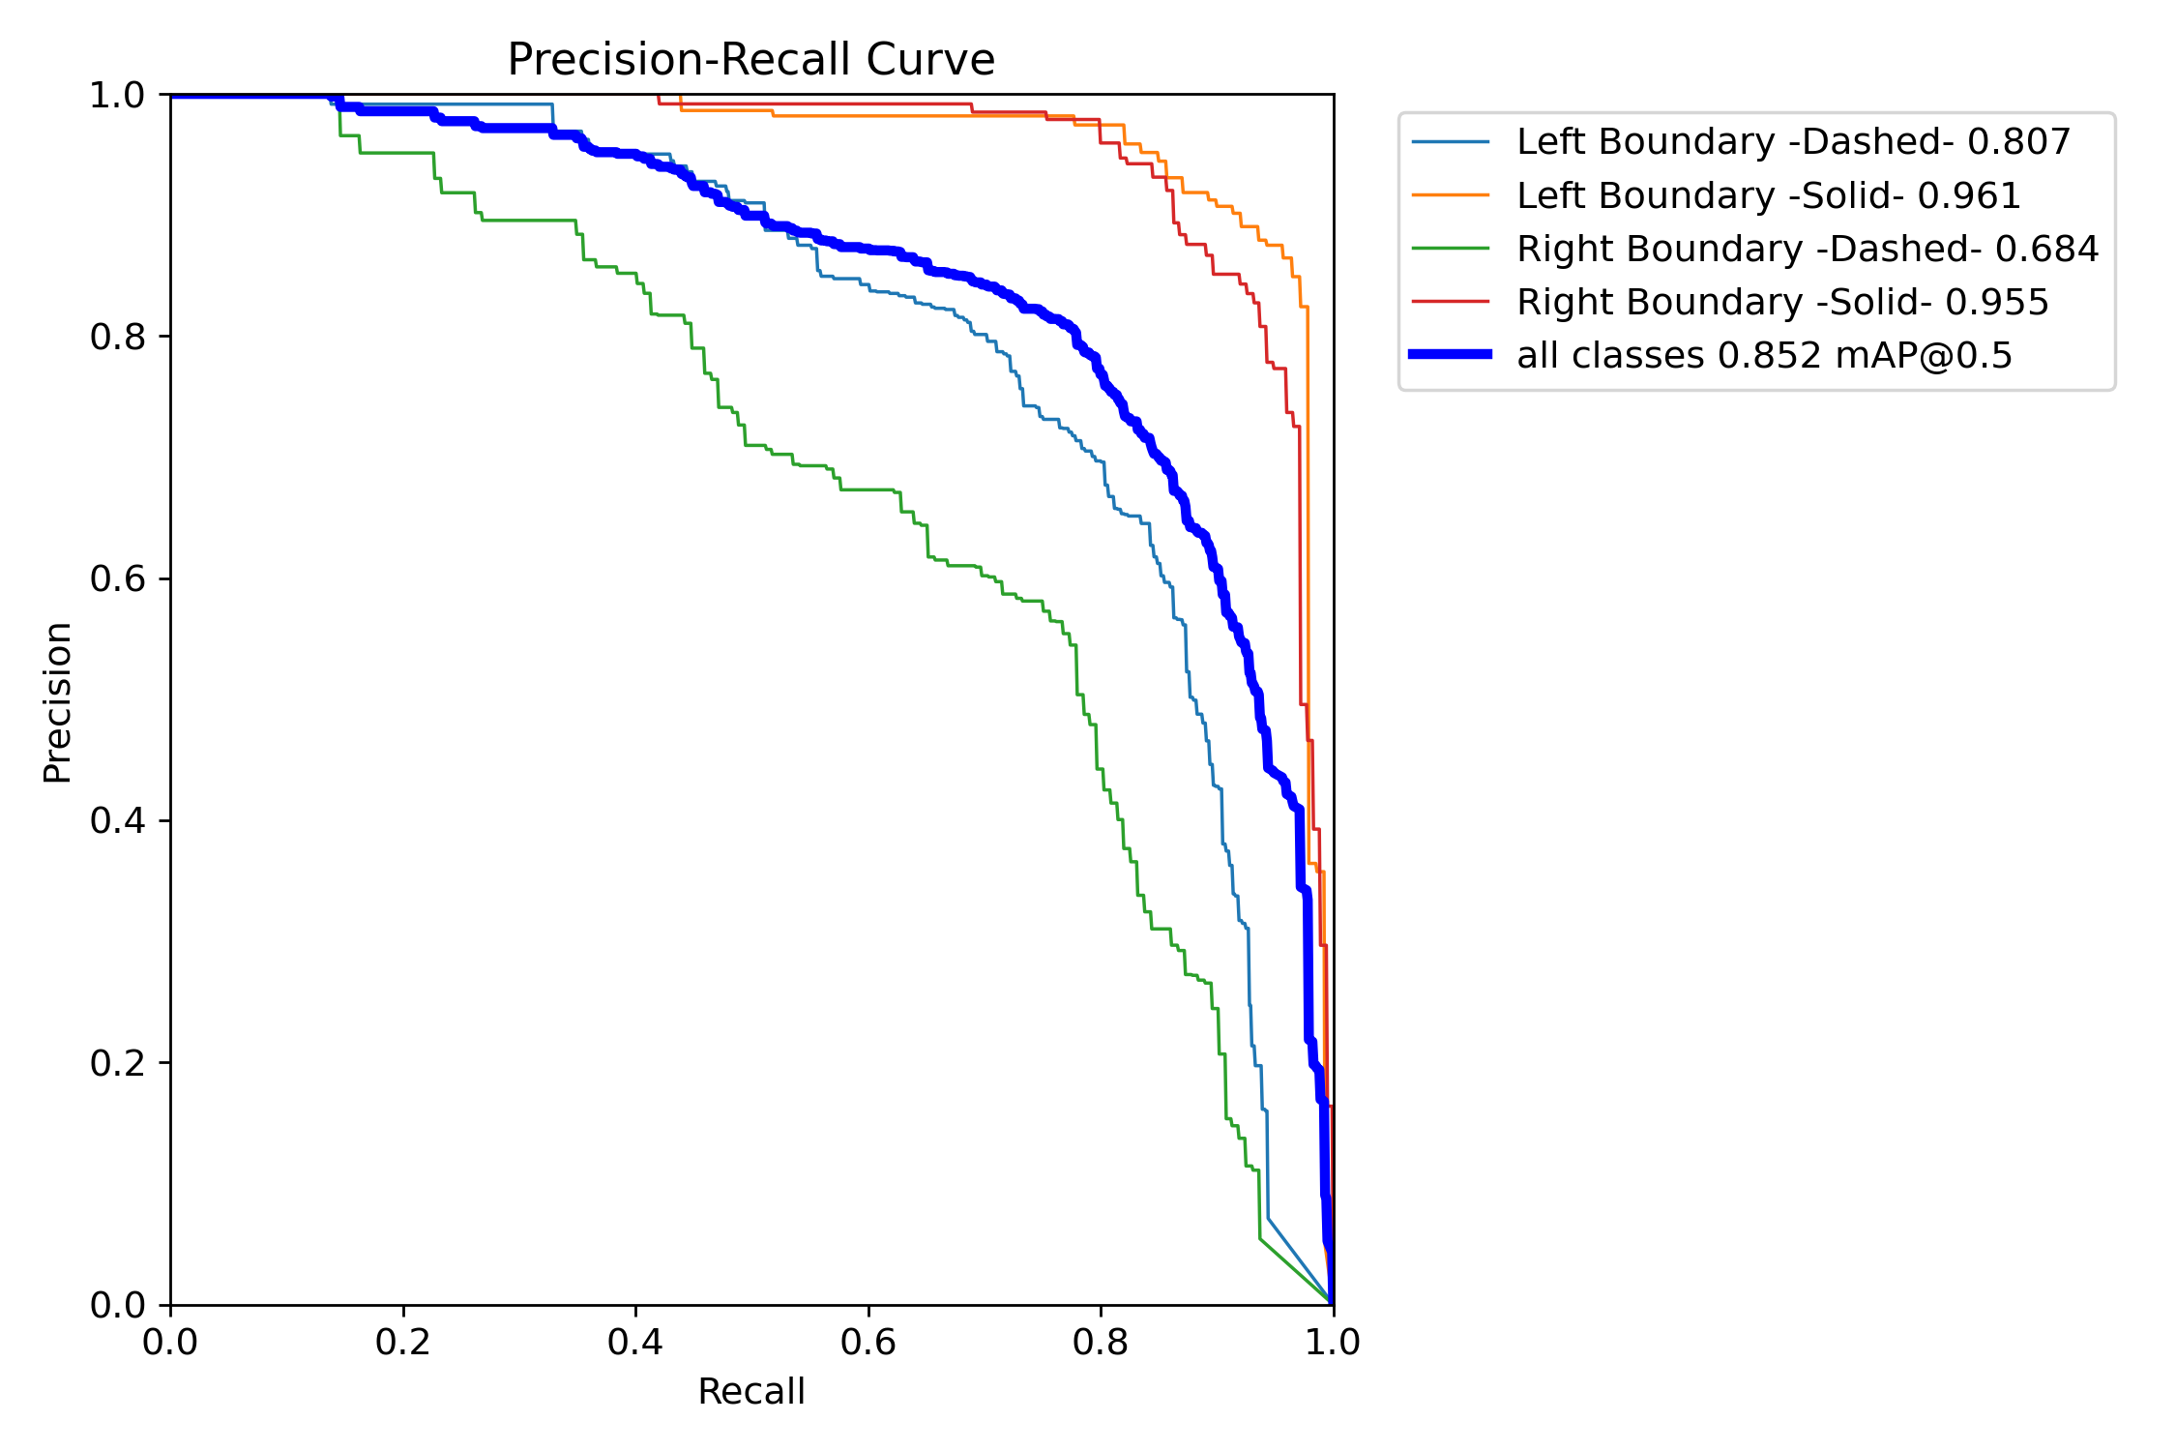
Precision Recall Curve

Slide 9
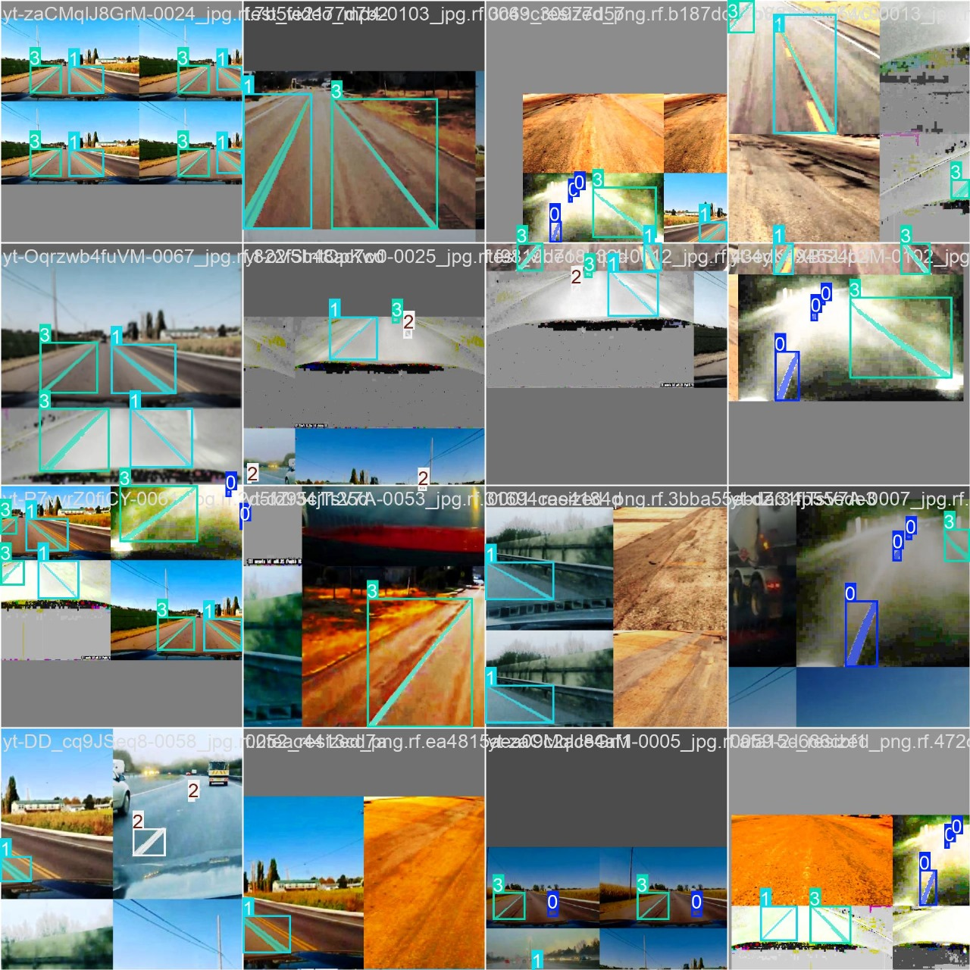
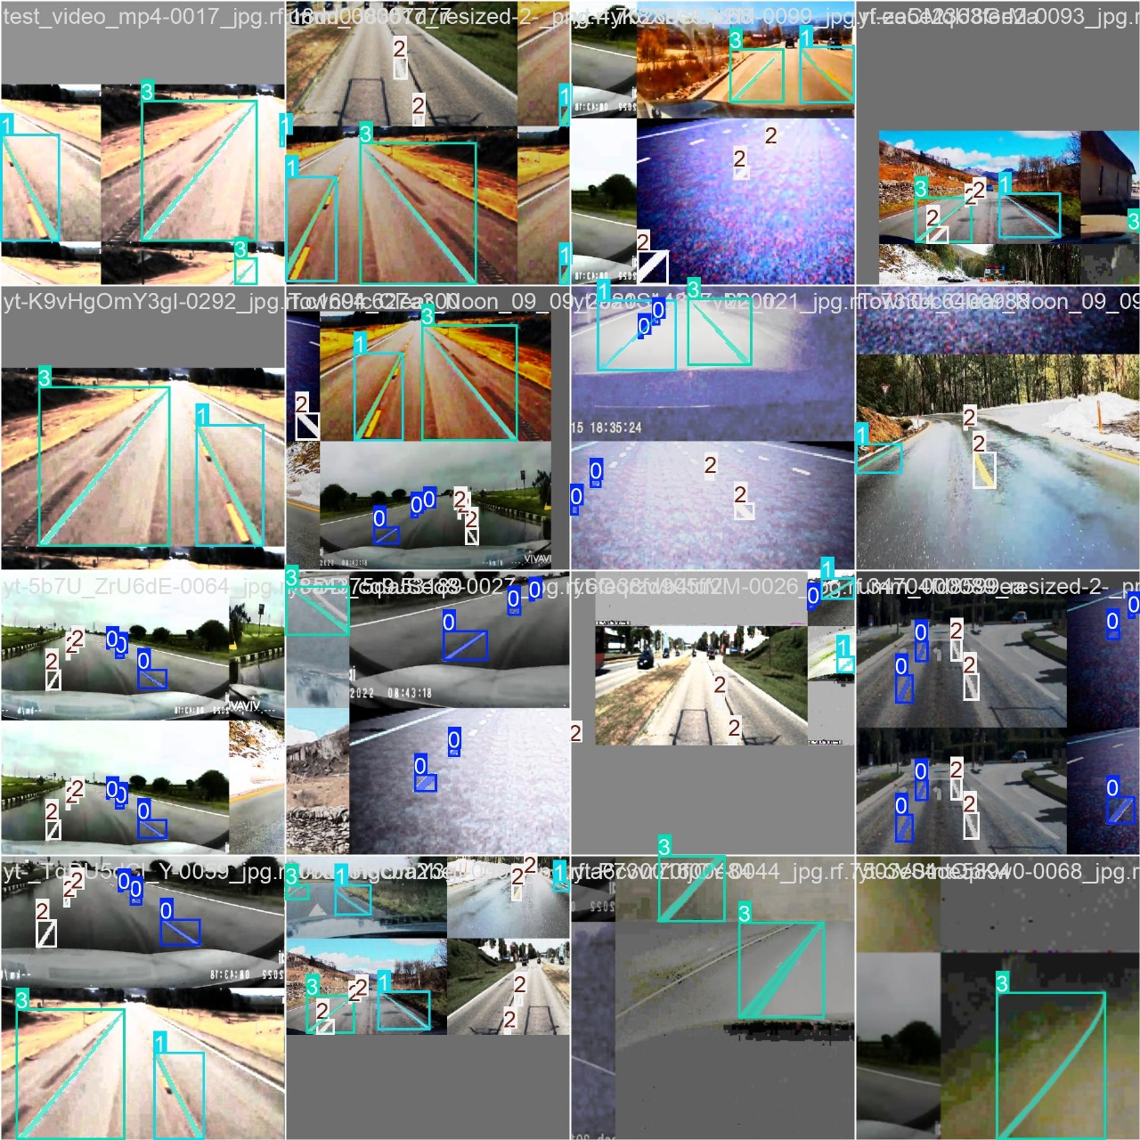
Trained Images

Slide 10
Advantages
Real-Time Detection: Fast and efficient lane and vehicle detection for autonomous driving or ADAS.
State-of-the-Art YOLOv8: High-accuracy vehicle detection with YOLOv8.
User-Friendly Interface: Streamlit provides an intuitive and accessible user experience.
Database Integration: Secure user management with SQLite and hashed passwords.
Scalable and Flexible: Easy to extend the system for additional objects or features.
Comprehensive Detection: Combines lane detection and vehicle recognition for a complete understanding of the road environment.

Slide 11
Limitations
Hardware Requirements: Large models may require high-end GPUs for efficient performance.
Domain-Specific Data: Requires a well-labeled dataset for optimal performance on custom tasks.
Anchor-Free Challenges: While anchor-free improves simplicity, it may underperform in specific scenarios compared to anchor-based models.
Video Handling: File size, format limitations, and potentially long processing times.

Slide 12
Result
Metrics to Monitor Real-Time Performance.
Inference Time: Time taken to process a single frame.
Detection Accuracy: Measure using Precision, Recall, and mAP.
FPS: Frames processed per second.
End-to-End Latency: Total time from image capture to displaying the output.

Slide 13
Conclusion
This research proposed a highly efficient and effective system for detection of road lane and vehicle detection system based on the advancement of capabilities of YOLOv8 algorithm in real-time object detection.
By employing YOLOv8 for lane detection and vehicle tracking, and Streamlit for an approachable user interface, our approach enables accurate detection and visualization of road components in a seamless interface across a variety of conditions.

Slide 14
Reference
1. Bhavana, N., M. M. Kodabagi, Kumar B., AjayP., N. Muthukumaran, A. Ahilan (2024). POTYOLO: Real-Time Road Potholes Detection using Edge Segmentation based Yolo V8Network. IEEE Sensors Journal.
2. Kaur, A., Kukreja, V., Thapliyal, N., Aeri, M.,Sharma, R., & Hariharan, S.(2024, March). A complete YOLOv8 model for traffic sign detection and classification. 2024 3rdInternational Conference for Innovation in Technology (INOCON), 1-5.
3. Haimer, Z., K. Mateur, Y Farhan, A A. Madi(2024, October). Road Marking Detection and Instance Segmentation Using YOLOv8Models. In 2024 10th International Conference on Optimization and Applications (ICOA) (pp.1-8). IEEE.
4. Liu, X., Y. Chu, Y Hu, N. Zhao (2024).Accelerating Target Monitoring Systems for Roads: A novel BGS YOLO strategy based onYOLOv8 IEEE Open Journal of Intelligent Transportation Systems.

